Slide 1
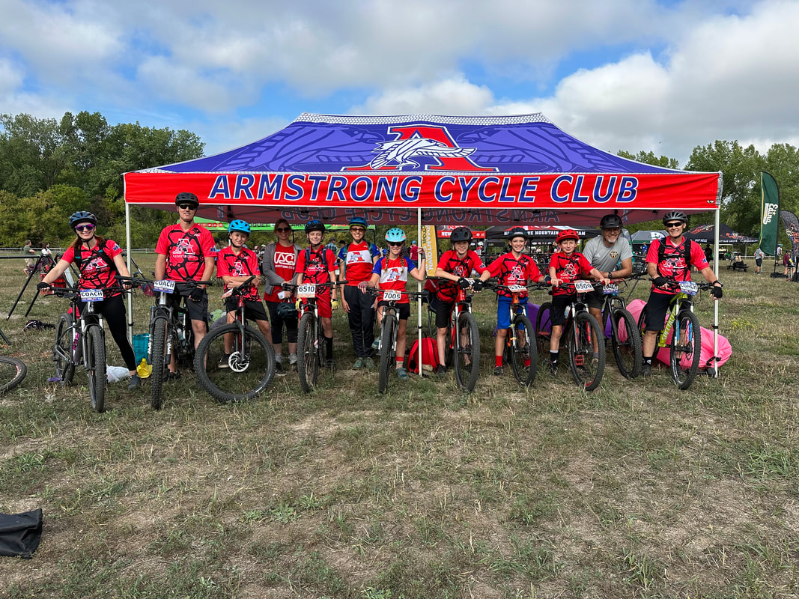
Armstrong
Cycle Club
2024 Season
Information and
Registration Night

Slide 2
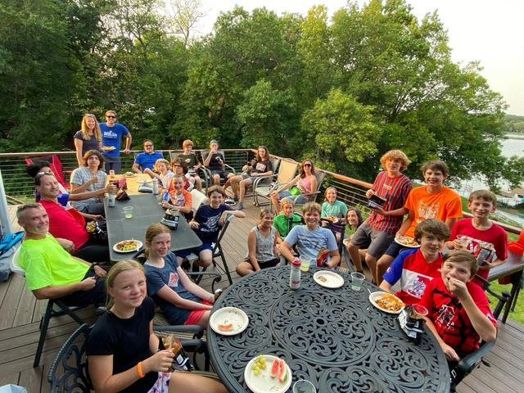
Welcome!
Introductions
Program Overview
Questions
Get Registered

Slide 3
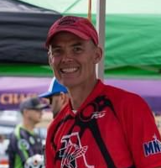
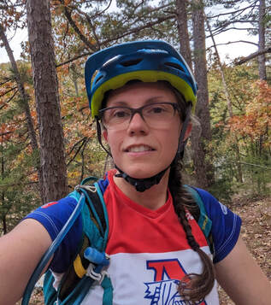
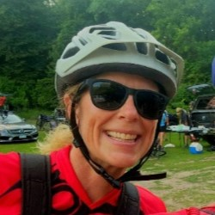
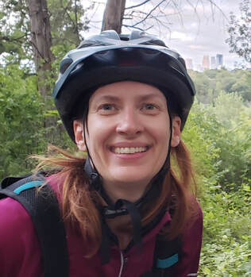
Club Leadership
Head Coaches
Chad Hollinbeck
Jenn Bouchey
Jenny Swanson
Board Members
Emily Knutson (Director)
Carrie Diaz (Treasurer)
Erik Hassis (Webmaster)
Stacie Mariette (Communications)
Erik Peters (Gear-Meister)
Carrie Schaefer (Apparel)

Slide 4
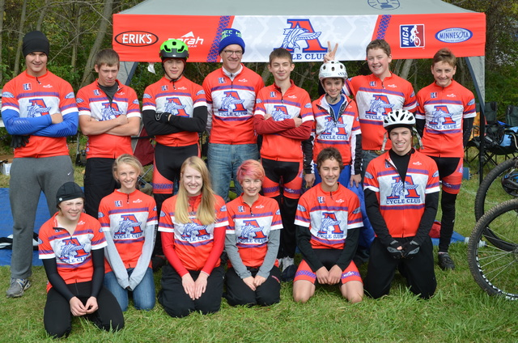
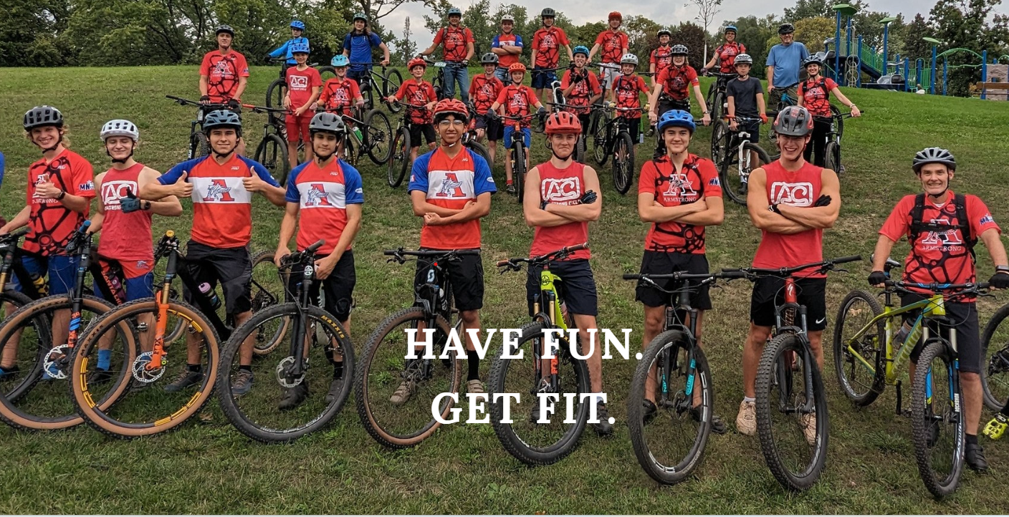
About Us
Founded in 2014
13 riders
MHSCL/NICA
Last year
45+ riders
MCA
All Skill Levels Welcome
100% Volunteer Run
www.armstrongcycleclub.com

Slide 5
Minnesota Cycling Association
Organization
80+ teams
2600+ riders
1300+ coaches
Core Values
Inclusivity: no benchwarmers, every finish counts
Equality: no try-outs, everyone rides
Strong Mind: student-athletes are first
Strong Body: lifelong fitness and good health start here
Strong Character: work hard, play fair, respect others
www.minnesotacycling.org

Slide 6
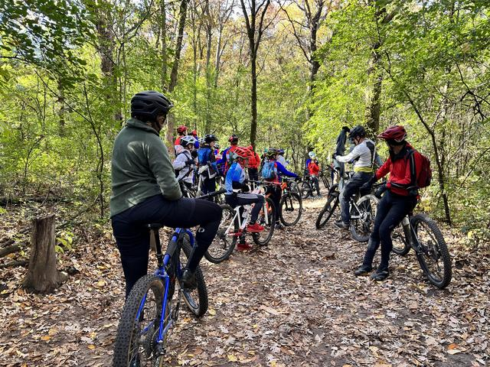
Practices
July – October
Three days per week, 2 1/2 hours
Tuesday evening
Thursday evening
Saturday morning
Warm-Up, Skills, Ride
Singletrack Trails
Theo Wirth
Elm Creek, Lebanon, Lake Rebecca
Paved Trails
Luce Line, Cedar Lake Trail, Greenway

Slide 7
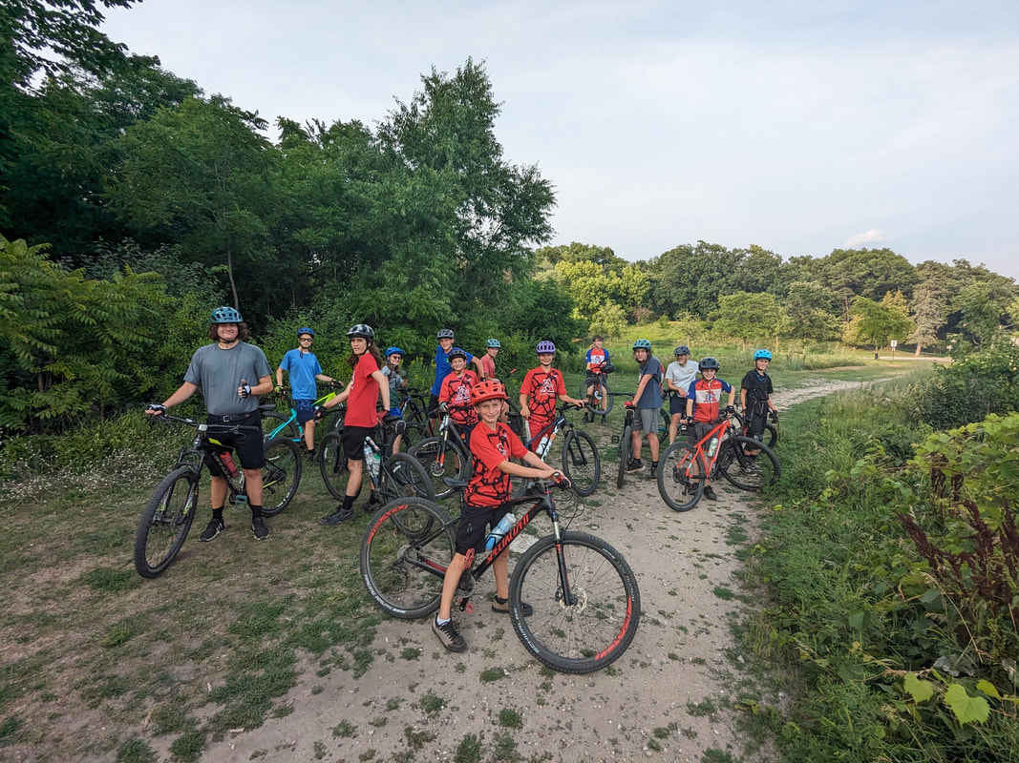
Expectations
Be on Time
Be Prepared
Team Snap Updates
Bike Check
Gear
Always Wear a Helmet
Follow Trail Rules/Etiquette
Respect Others
Stay with Your Group

Slide 8
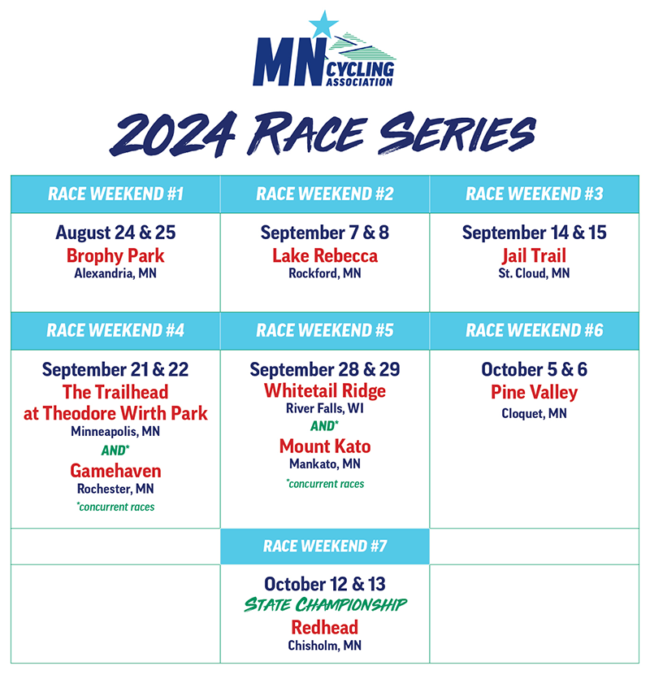
Our Race Schedule
Weekend #1
Brophy Park
Alexandria, MN
Weekend #4
Theodore Wirth Park
Minneapolis, MN
Weekend #5
Whitetail Ridge
River Falls, WI
Weekend #6
Pine Valley
Cloquet, MN
State Championship
Redhead
Chisholm, MN

Slide 9
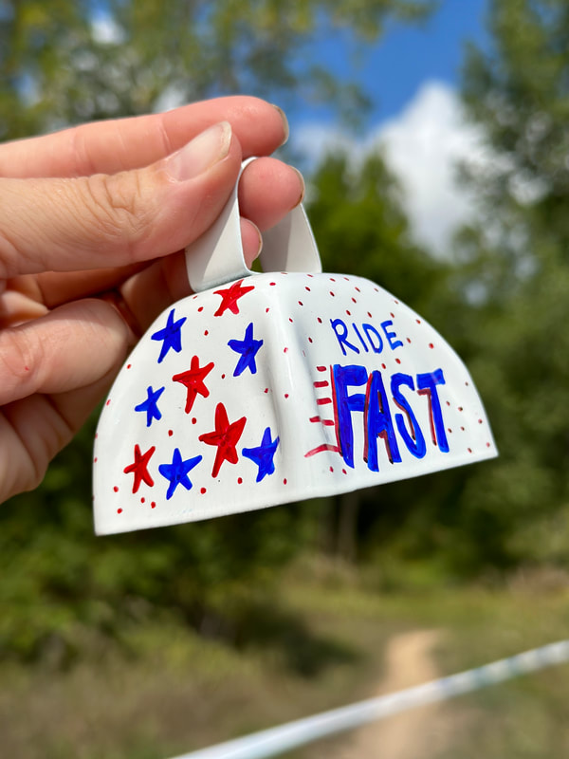
Races
Categories
Age/Ability
Boys/Girls
Team Size
Saturdays – Middle School
6th Grade – one lap
7th Grade – one lap
8th Grade – one lap
Sundays – High School
Freshmen – two laps
JV2 – two laps
JV3 – three laps
Varsity – four laps

Slide 10
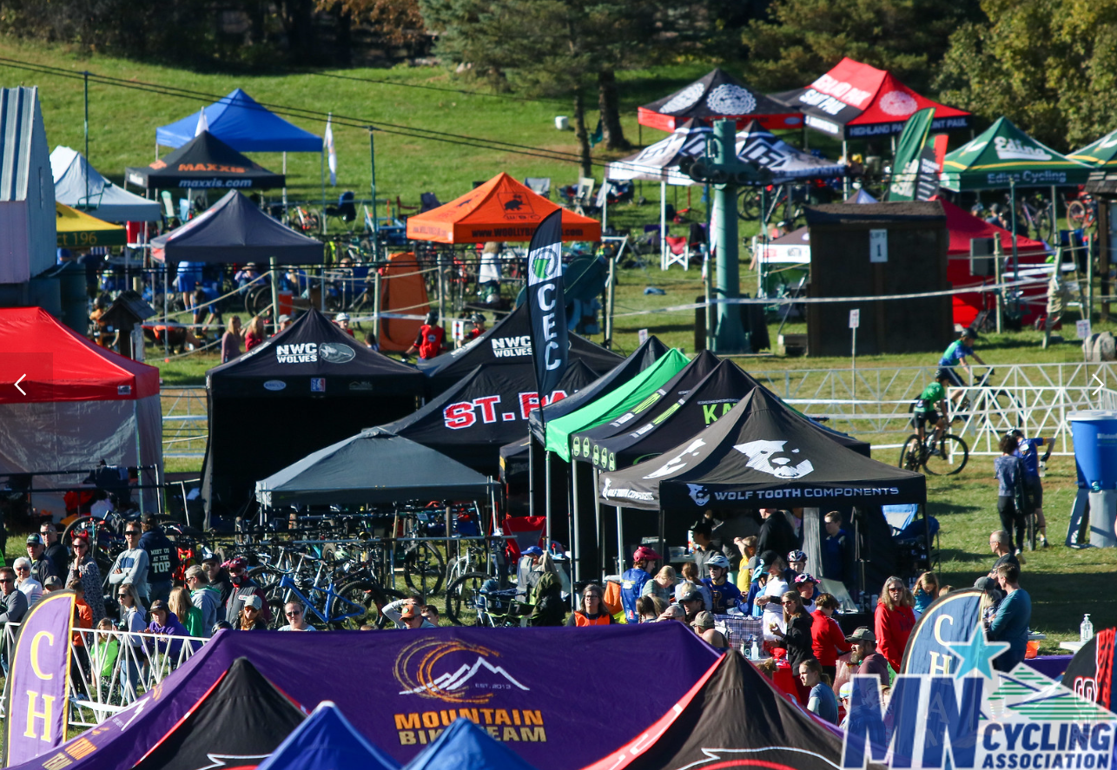
Race Day
Pre-Rides
Warm Up, Staging, Race Start
Timing
Results
www.precisionracing.com
Pictures
www.minnesotamtb.smugmug.com

Slide 11
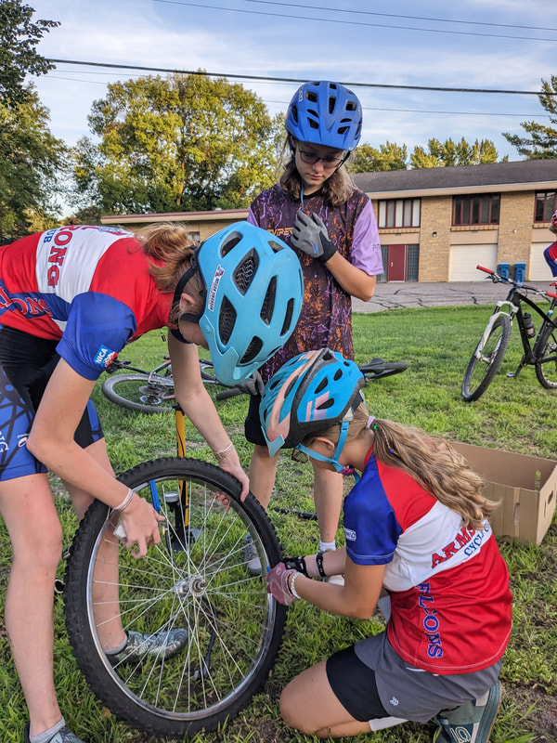
Gear
Bike
Helmet
Water Bottle
Multi-Tool
Spare Tube
Bike Bag
CO2/Pump
Light
Quick Dry Clothing
Bike Gloves
Bike Shoes

Slide 12
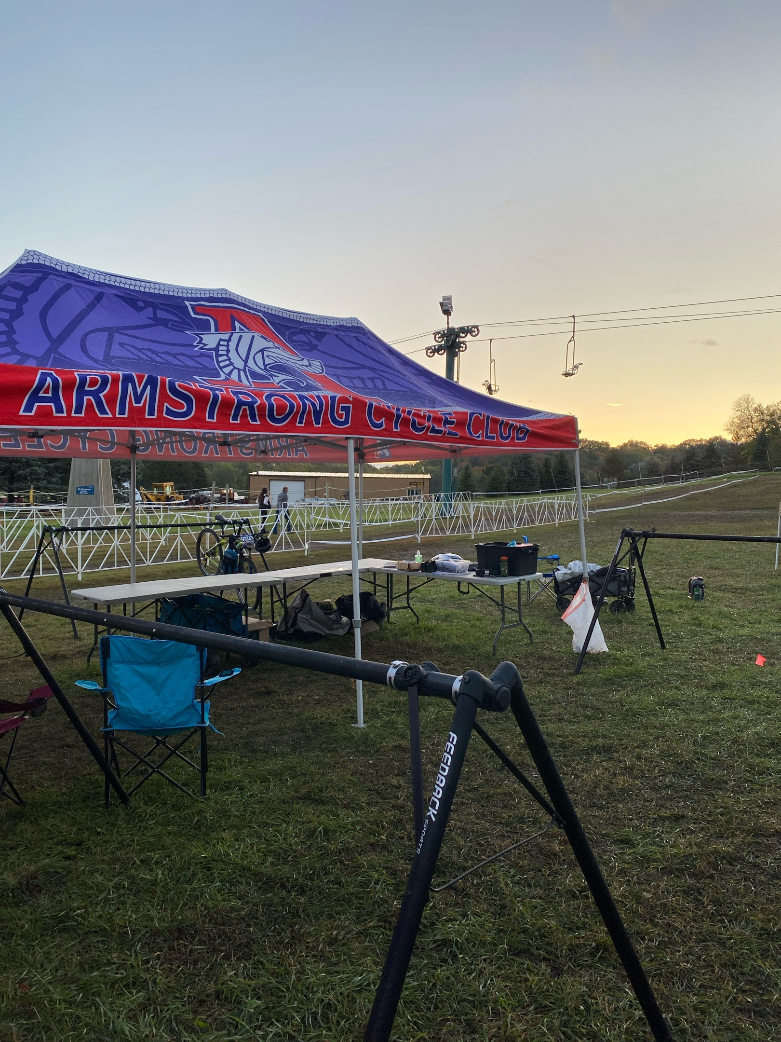
Costs
MCA Registration $100
(required)
ACC Dues $150
(required)
Race Registration $50-$150
(optional)
Race Jersey $40
(required to race)

Slide 13
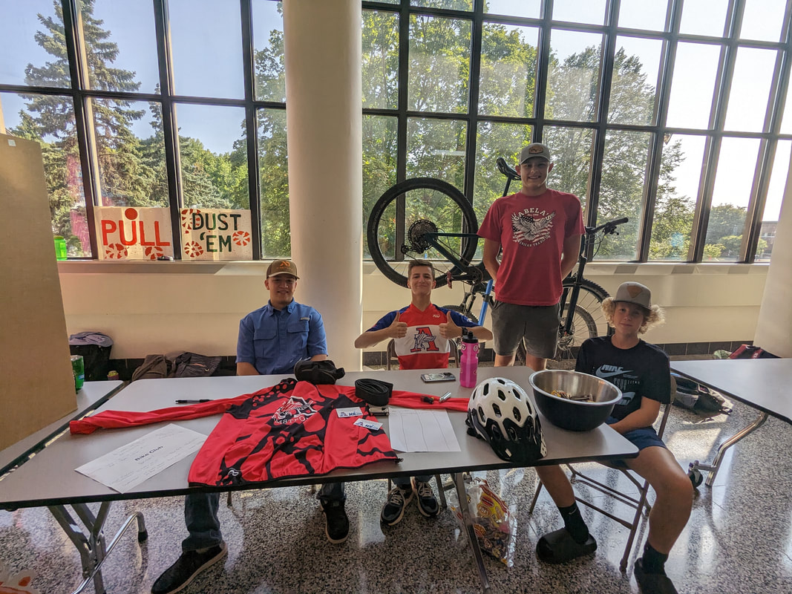
Get Involved
Ride Volunteers
Fundraising
Photographer/Videographer
Event Planning
Race Volunteers

Slide 14
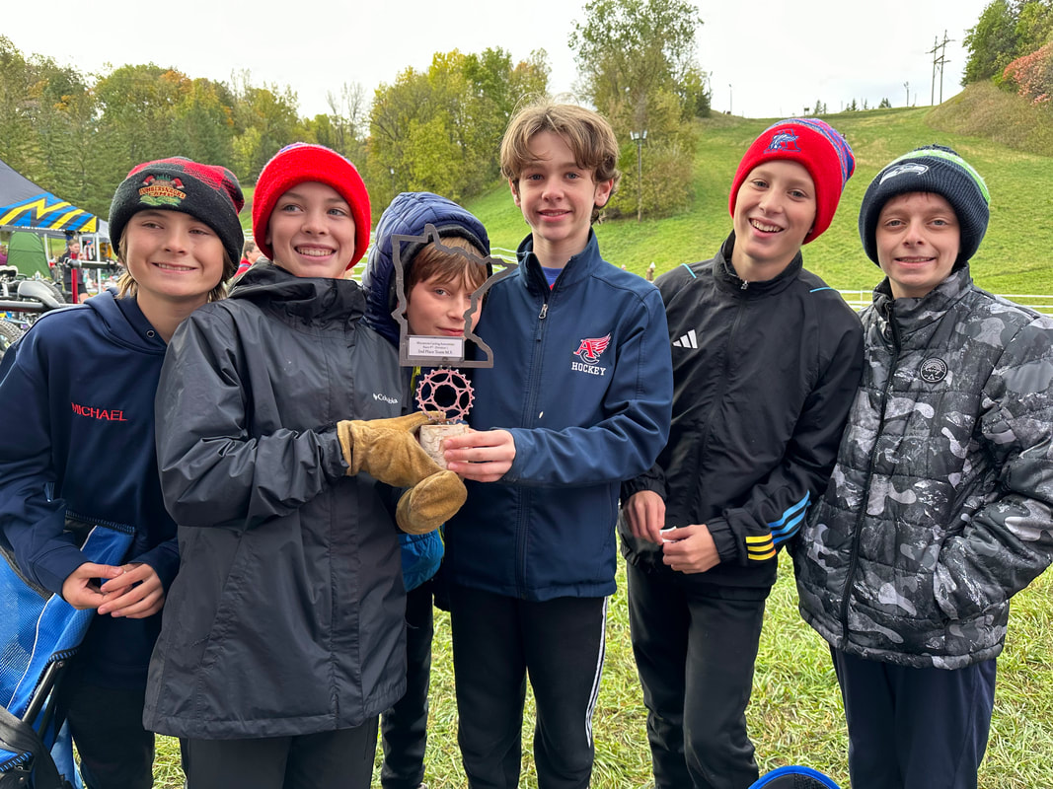
Questions
www.armstrongcycleclub.com
www.minnesotacycling.org

Slide 15
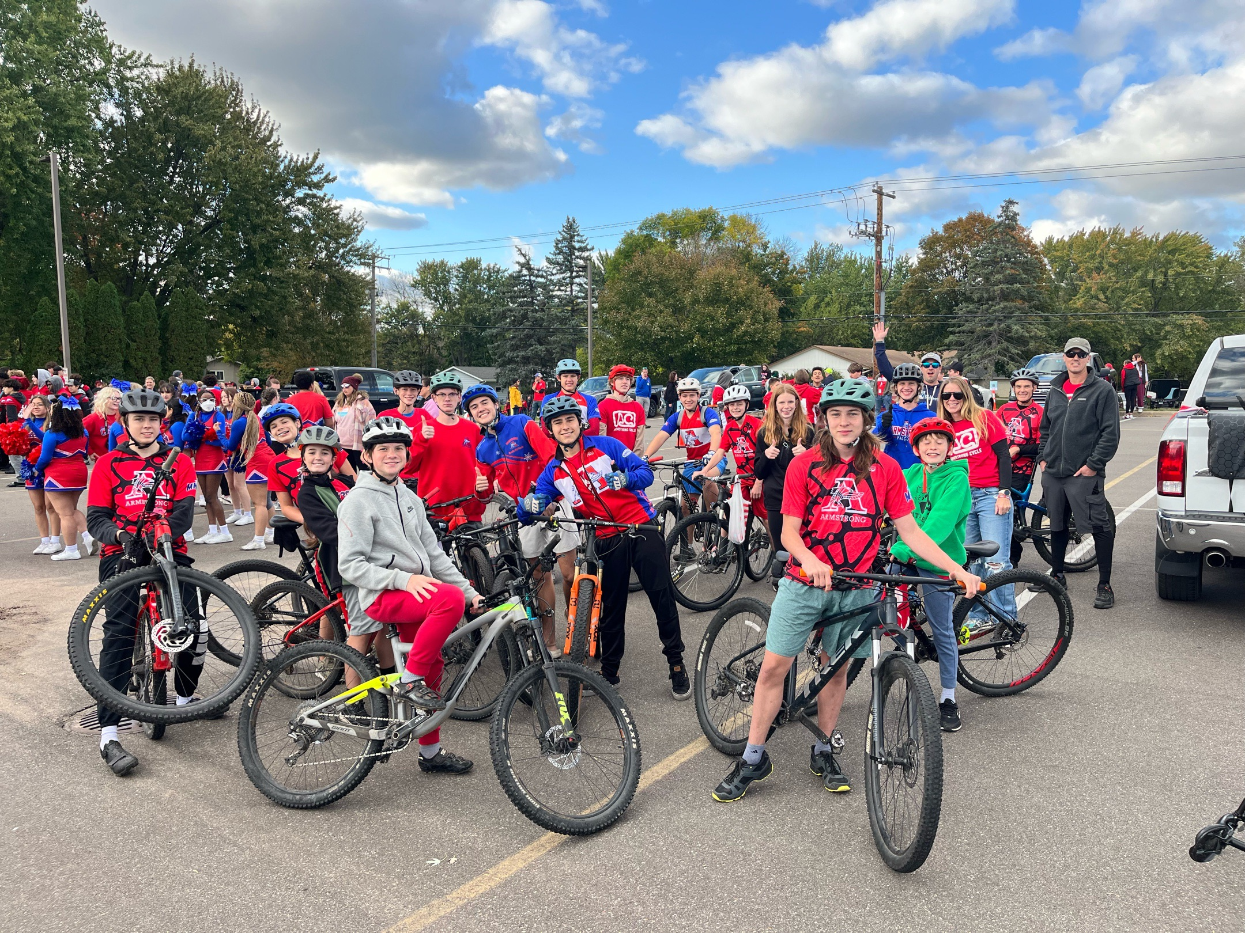
Thank you for coming!

